Slide 1
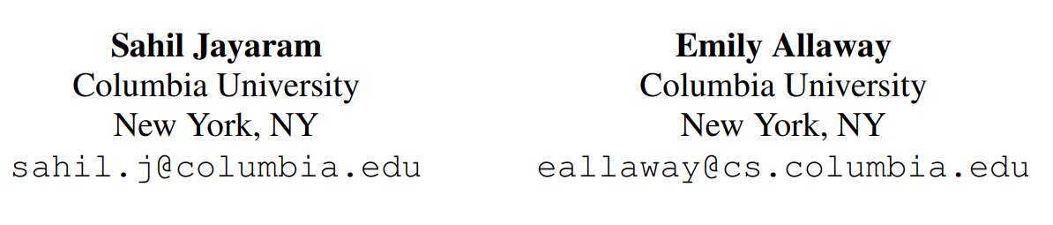
Human Rationales as Attribution Priors for Explainable Stance Detection
ACL November 2021
Presenter : Guo Zikun

Slide 2
Contents
Introduction
Method -Mean attention weights (MAW).
Result
Conclusion

Slide 3
Introduction
As NLP systems become better at detecting opinions and beliefs from text, it is important to ensure not only that models are accurate but also that they arrive at their predictions in ways that align with human reasoning.
Imparting human-like rationalization to a stance detection model using crowdsourced annotations on a small fraction of the training data.
Improve the reasoning of a state-of-the-art classifier
Attention weights surpass a leading attribution method in providing faithful explanations of our model’s predictions,
Notes:
随着 NLP 系统在从文本中检测观点和信念 方面变得越来越好，重要的是不仅要确保 模型是准确的，而且要确保它们以符合人 类推理的方式来实现预测。
将类似人类 的合理化传递给姿态检测模型
我们的方法可 以提高最先进的分类器的推理能力
注意力权重在提供模型预测的可靠解释方 面优于领先的归因方法

Slide 4
Stance detection
Stance detection, :
Automatically identifying the position on a topic taken by a text. allows readers to glean valuable information from news articles and social media, such as whether the writing is politically slanted.
Sensitivity
Stand model transparent
predictions in human-like ways.
Notes:
姿态检测，自动识别文本在主题上的位置 (Mohammad et al.,2017)，允许读者从新闻文 章和社交媒体中收集有价值的信息，比如文章 是否有政治倾向。

Slide 5
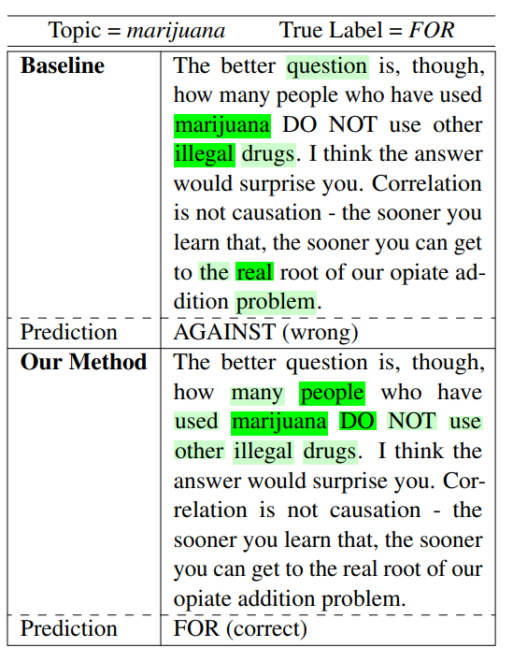
Mean attention weights (MAW).
Model reasoning as explained by mean attention weights (MAW). The baseline is trained using only cross-entropy loss, while the second model is trained using our proposed attribution prior.

Slide 7
Stance detection
Stance detection, :
automatically identifying the position on a topic taken by a text

Slide 8
Stance detection
Stance detection, :
automatically identifying the position on a topic taken by a text

Slide 9
Stance detection
Stance detection, :
automatically identifying the position on a topic taken by a text

Slide 10
Stance detection
Stance detection, :
automatically identifying the position on a topic taken by a text

